Slide 1

OOP Project #3
Team 14
Team Member
20200009 김동영
20200699 박혜인
20200479 정수용

Slide 2


Contents
Introduce members and roles
Introduce the program
Review Codes
Execute

Slide 3
Members
김동영
- Plan and implement program
박혜인
- Plan and implement program
정수용
- Write a report and make presentation

Slide 4
Introduce the program
Our program is…
Simple Shooting Game
When starting program, you will see the billiards table viewed from above
Bombs and marbles fall randomly
Just hit the bomb by shooting the ball and get rid of it.

Slide 5
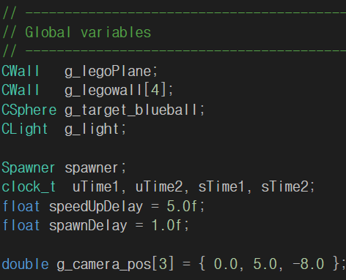
Review
Codes
Global Variables
Spawner object spawner
uTime1, uTime2
sTime1, sTime2
speedUpDelay
spawnDelay

Slide 6
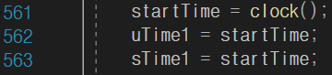
Review
Codes
Setup()

Slide 7
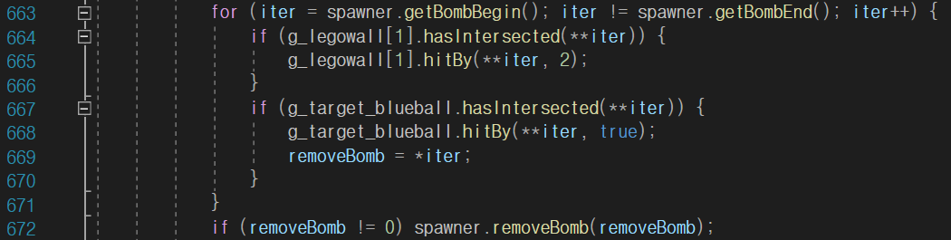
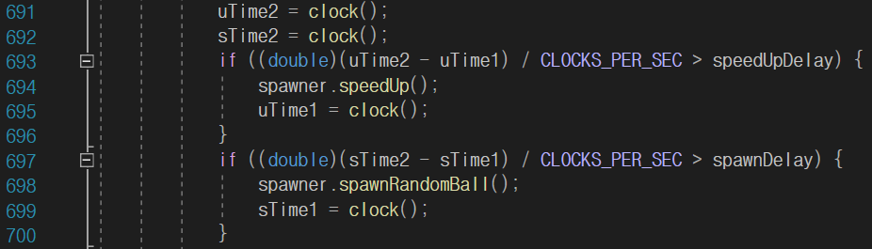
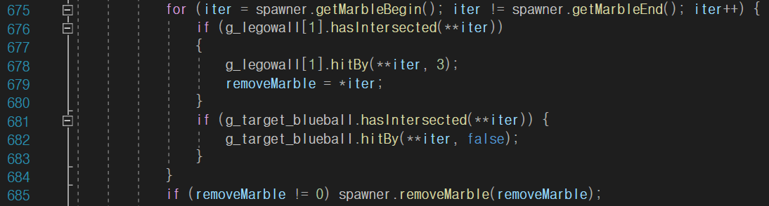
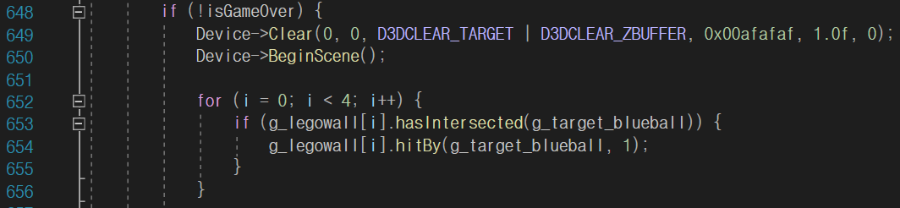
Review
Codes
Display()

Slide 8
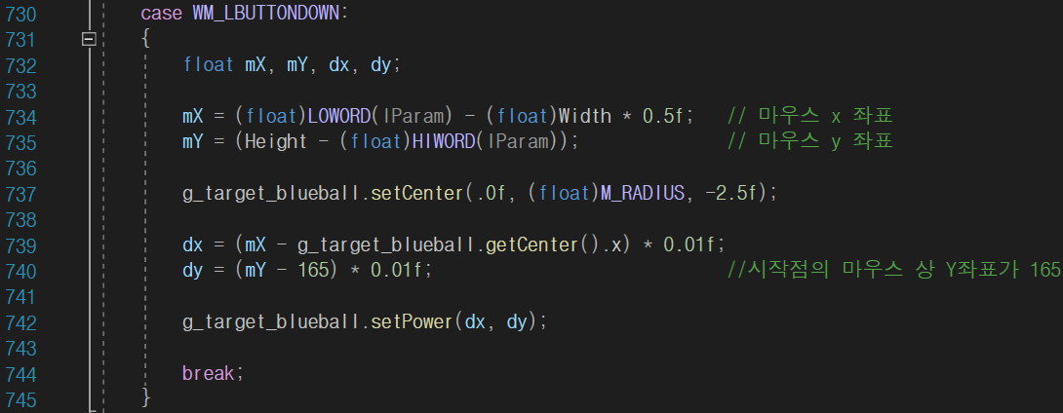
Review
Codes
LRESULT CALLBACK d3d::WndProc(…)

Slide 9
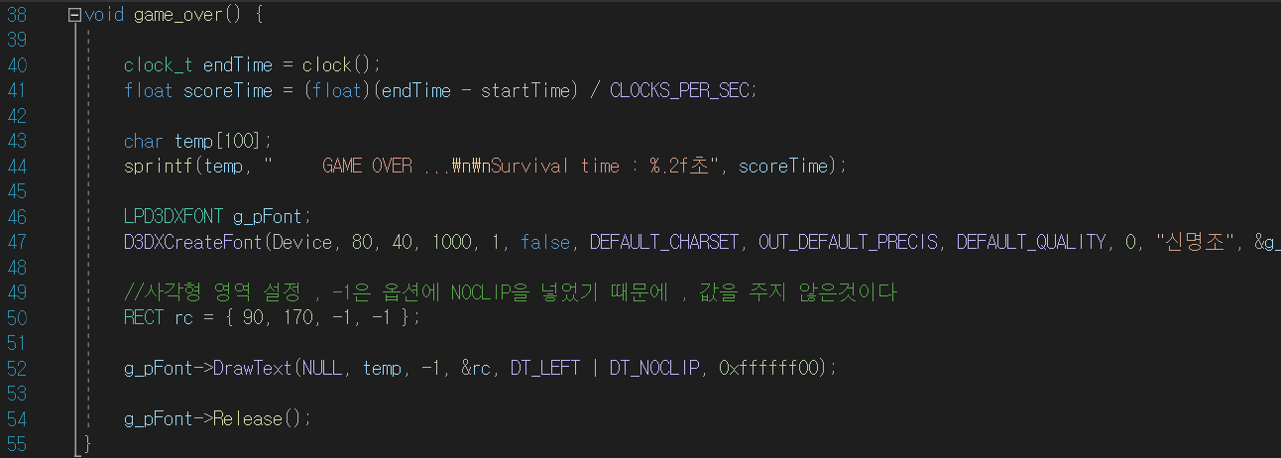
Review
Codes
game_over()

Slide 10
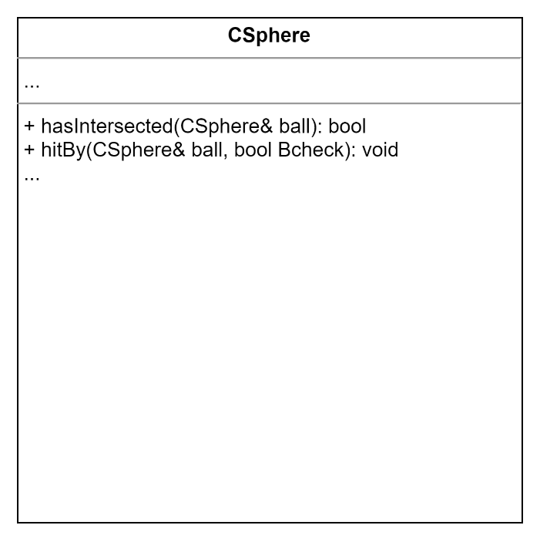
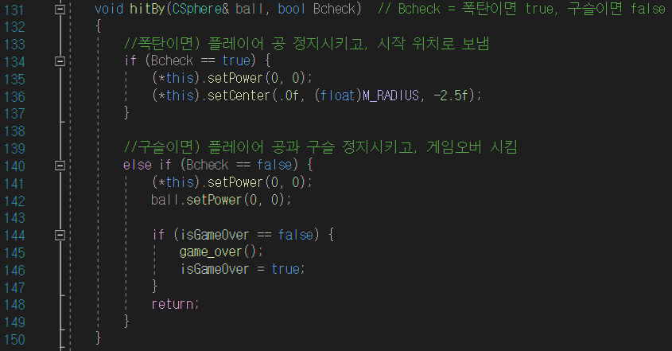
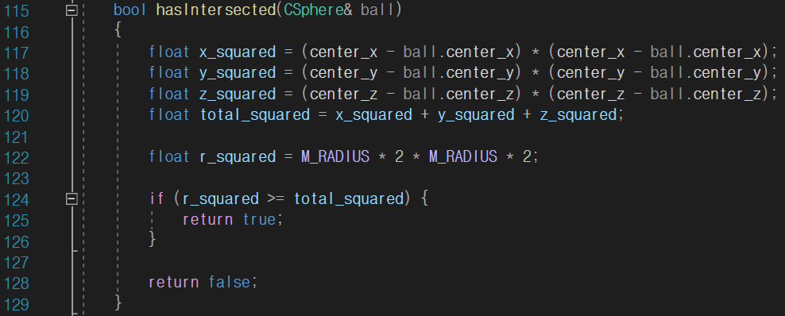
Review
Codes
CSphere class
Class for interactions between the player’s ball and bombs and marbles

Slide 11
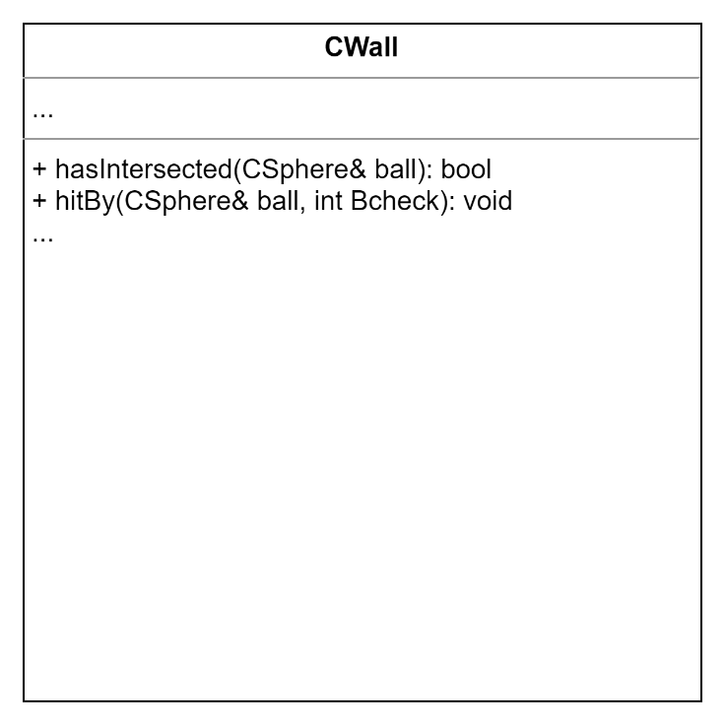
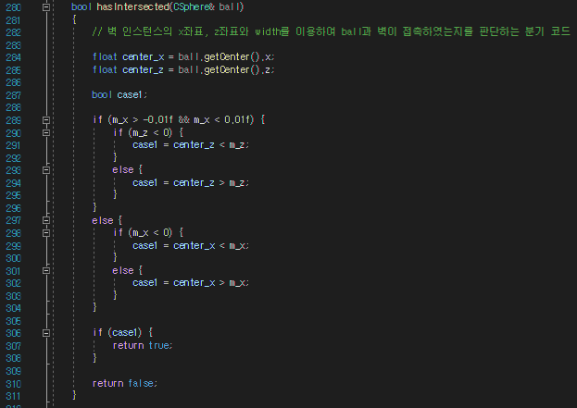
Review
Codes
CWall class
Class for interactions between all balls including player’s ball, bombs, and marbles and four walls

Slide 12
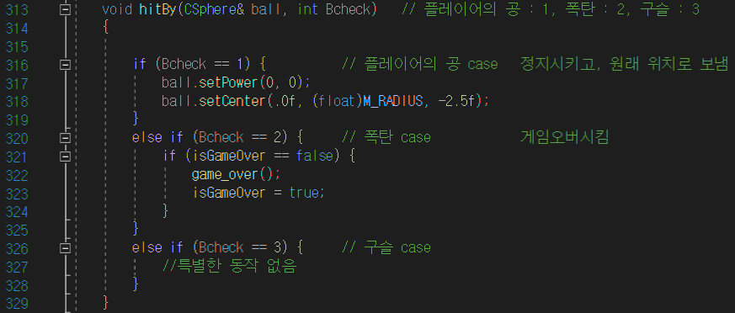
Review
Codes
CWall class
Class for interactions between all balls including player’s ball, bombs, and marbles and four walls

Slide 13
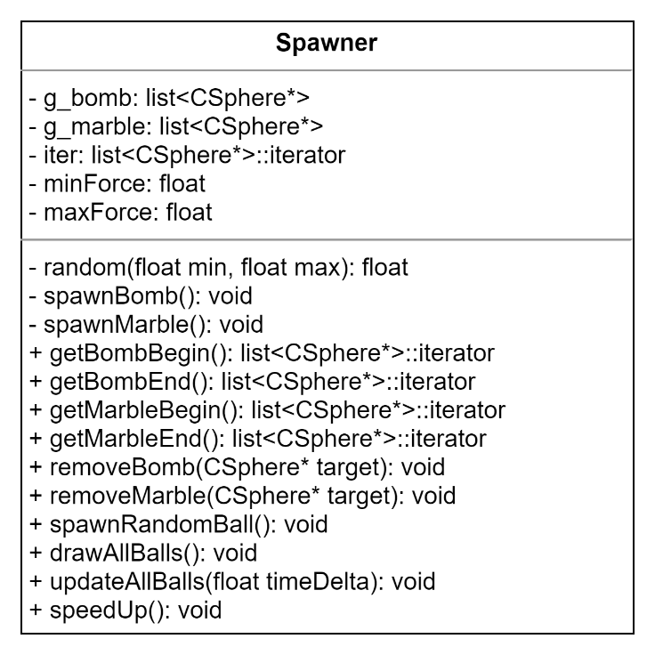
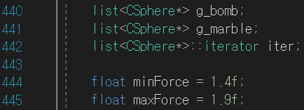
Review
Codes
Spawner class
Class for summon balls, marbles and to perform
the function of controlling their speed and spawning

Slide 14
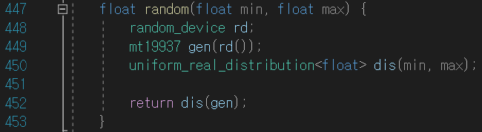
Review
Codes
Spawner class
Class for summon balls, marbles and to perform
the function of controlling their speed and spawning

Slide 15
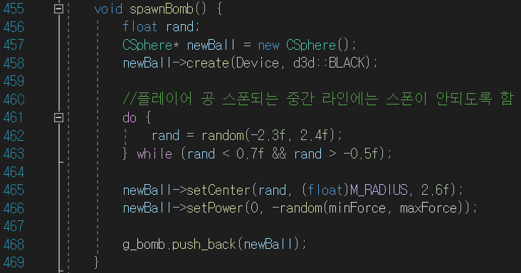
Review
Codes
Spawner class
Class for summon balls, marbles and to perform
the function of controlling their speed and spawning

Slide 16
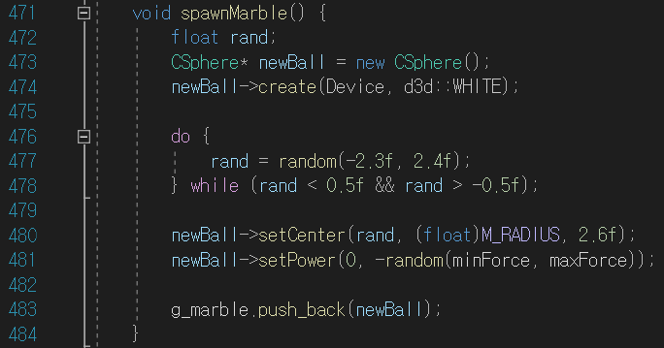
Review
Codes
Spawner class
Class for summon balls, marbles and to perform
the function of controlling their speed and spawning

Slide 17
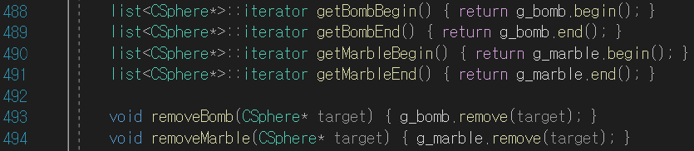
Review
Codes
Spawner class
Class for summon balls, marbles and to perform
the function of controlling their speed and spawning

Slide 18
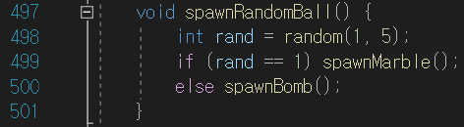
Review
Codes
Spawner class
Class for summon balls, marbles and to perform
the function of controlling their speed and spawning

Slide 19
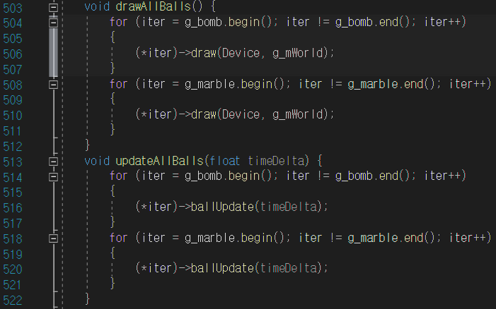
Review
Codes
Spawner class
Class for summon balls, marbles and to perform
the function of controlling their speed and spawning

Slide 20
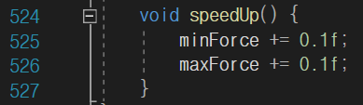
Review
Codes
Spawner class
Class for summon balls, marbles and to perform
the function of controlling their speed and spawning

Slide 21
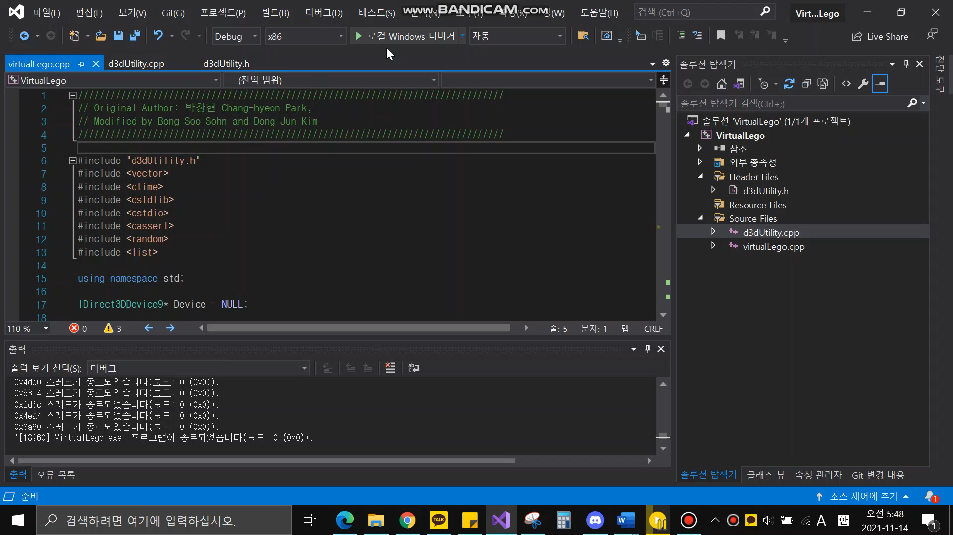
Execute
Let’s play the game!

Slide 22
Thank you for listening!

